Slide 1

INSTAGRAM USER ANALYTICS

Slide 2
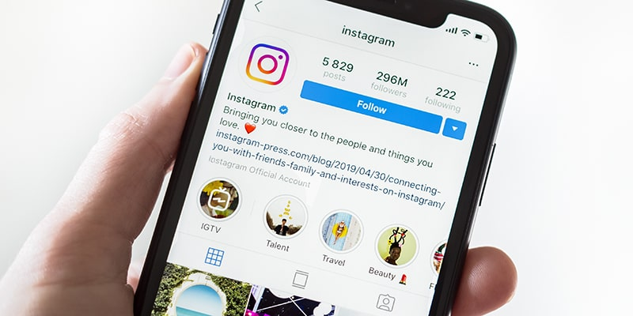
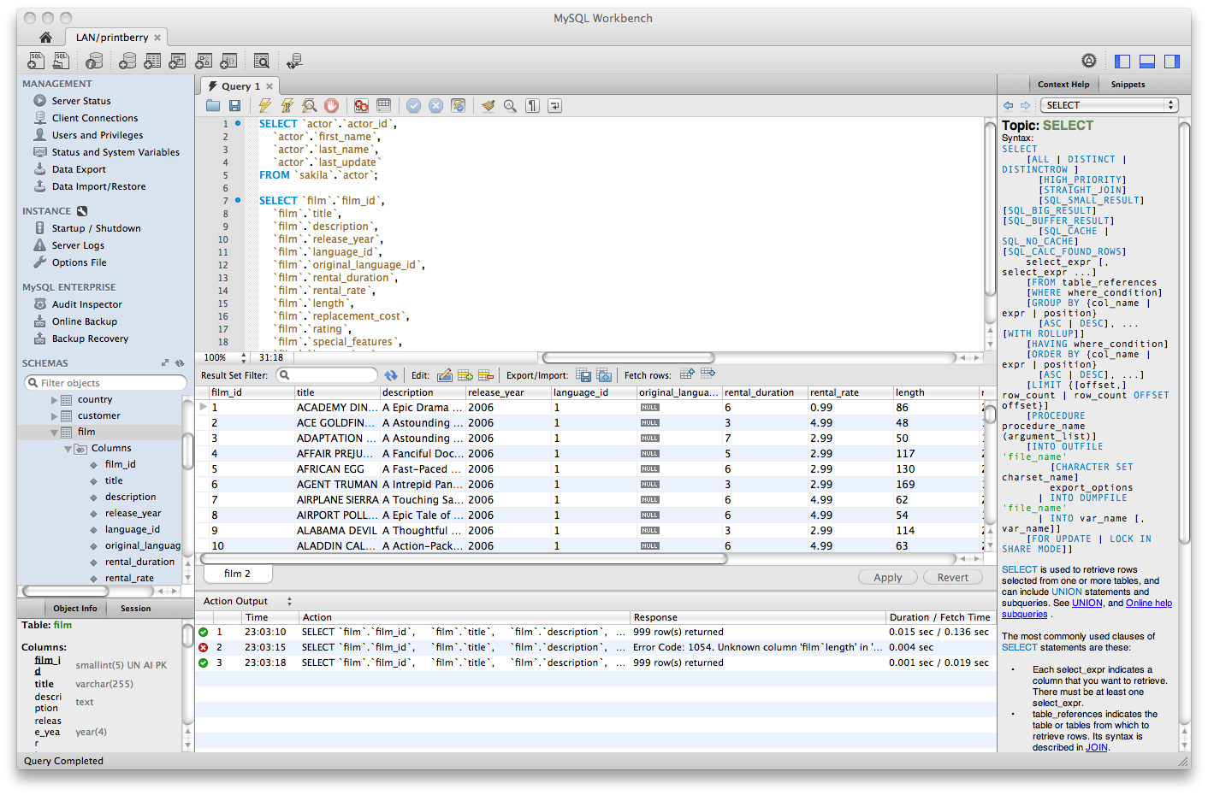
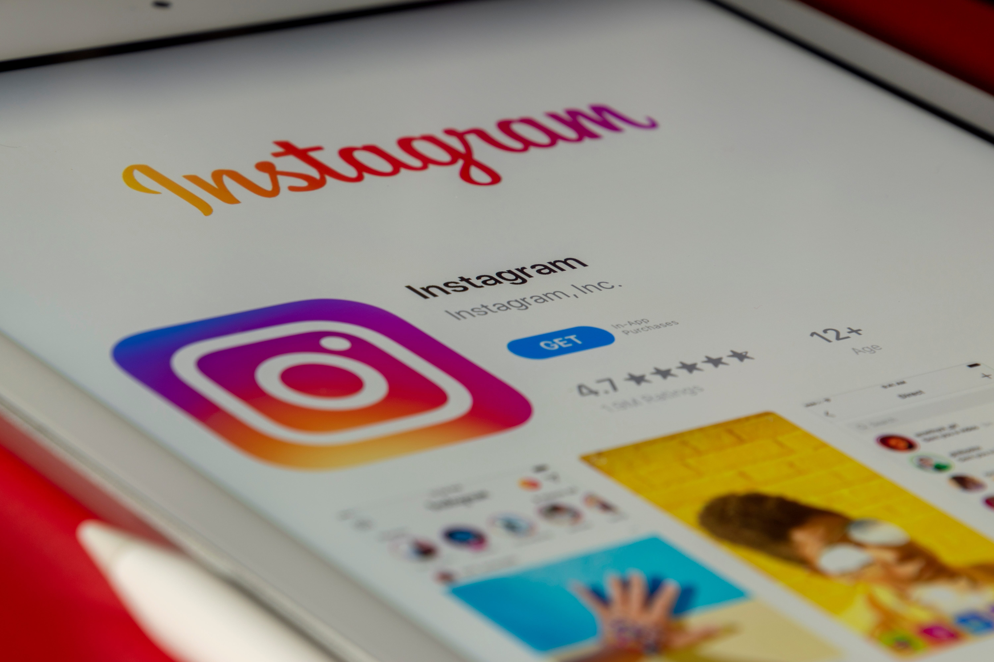

PROJECT 2

Slide 3
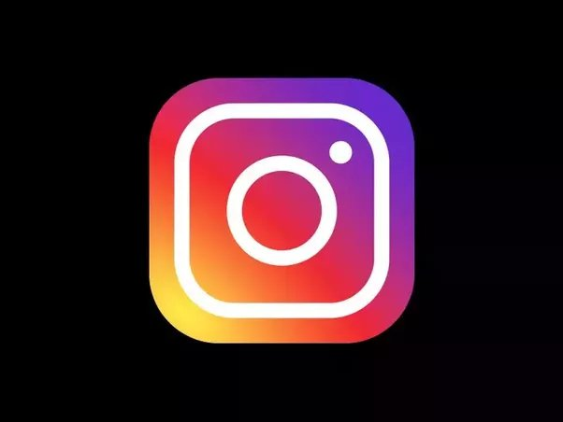
INTRODUCTION
Instagram is a widely known social networking app that has amassed millions of data every day. As Data Analyst, we are responsible for analyzing this data and extracting valuable insights to aid the company.

Slide 4
For this project, I have utilized SQL and MySQL Workbench to analyze user data from Instagram and provide insights to the management team. My findings will assist the product manager and the team in making informed decisions regarding the app's future direction.

Slide 5

MYSQL
For this project,MYSQL was used as it :
Ensures data integrity
Data is easily shared
Data can be accessed easily
Being portable and lightweight

Slide 6
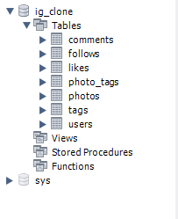
PROJECT DETAILS
Database ig_clone was created.
Several tables were also created:
Users
Photos
Comments
Follows
Likes
Tags
photo_tags

Slide 7
Marketing Analysis

Slide 8
LOYAL USER REWARD
The marketing team wants to reward the most loyal users, those who have been using the platform for the longest time.

Slide 9
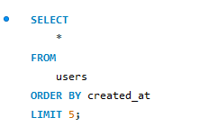
MYSQL QUERY
TASK:
To identify the five oldest users on Instagram from the provided database.

Slide 10
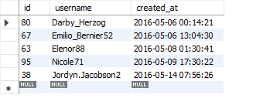
OUTPUT

Slide 11
RESULT
From the output we can see that username Darby_Herzog, Emilio_Bernier52, Elenor88, Nicole71, Jordyn.Jacobson2 are the five most loyal user.

Slide 12
INACTIVE USER ENGAGEMENT
The team plans to send promotional emails to inactive users to encourage them to start posting.

Slide 13
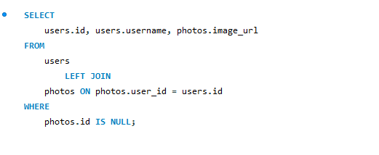
MYSQL QUERY
TASK:
To identify users who have never posted a single photo on Instagram.

Slide 14
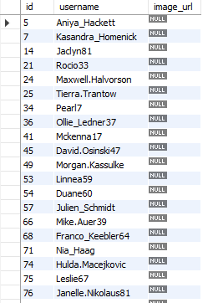
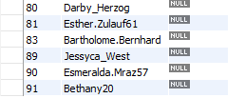
OUTPUT

Slide 15
RESULT
The output shows the people who have never posted once.

Slide 16
CONTEST WINNER DECLARATION
The team has organized a contest where the user with the most likes on a single photo wins.

Slide 17
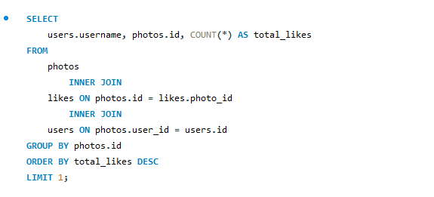
MYSQL QUERY
TASK:
To determine the winner of the contest and provide their details to the team.

Slide 18
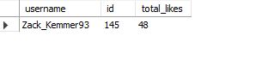
OUTPUT

Slide 19
RESULT
Output shows user id 145 with username Zack_Kemmer93 has the most likes on its post.

Slide 20
HASHTAG RESEARCH
A partner brand wants to know the most popular hashtags to use in their posts to reach the most people.

Slide 21
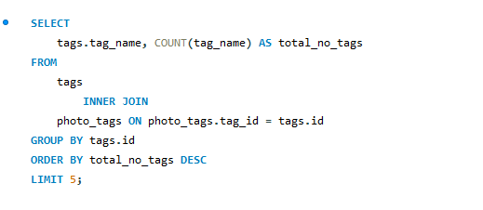
MYSQL QUERY
TASK:
To identify and suggest the top five most commonly used hashtags on the platform.

Slide 22
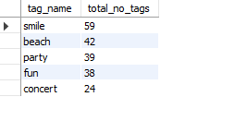
OUTPUT

Slide 23
RESULT
The five most commonly used hashtags are:
Smile
Beach
party
fun
concert

Slide 24
AD CAMPAIGN LAUNCH
The team is seeking information on the optimal day of the week to launch their advertisements.

Slide 25
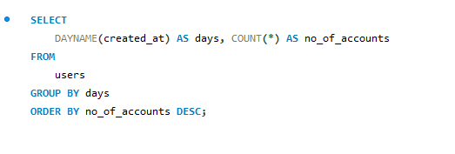
MYSQL QUERY
TASK:
To determine the day of the week when most users register on Instagram.

Slide 26
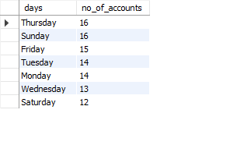
OUTPUT

Slide 27
RESULT
From the Output it is clear that Thursdays and Sundays are the days when most people register on Instagram

Slide 28

SUMMARY
LOYAL USER REWARD
Username Darby_Herzog, Emilio_Bernier52, Elenor88, Nicole71, Jordyn.Jacobson2 are most loyal .
INACTIVE USER ENGAGEMENT
There are 26 inactive users on the app.
AD CAMPAIGN LAUNCH
Thursdays and Sundays are days when most users register on Instagram
CONTEST WINNING DECLARATION
HASHTAG RESEARCH
Zack_Kemmer93 is the winner of the contest
Smile, beach, party, fun, and contest are the most common hashtags
Objectives Powerpoint Template

Slide 29
Investor metrics

Slide 30
USER ENGAGEMENT
Investors are interested in knowing if Instagram users are still actively posting or reducing their activity.

Slide 31
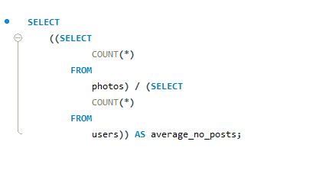
MYSQL QUERY
TASK:
To calculate the average number of posts per user on Instagram.

Slide 32
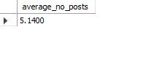
OUTPUT

Slide 33
RESULT
The average number of posts on Instagram is 5.14.

Slide 34
BOTS AND FAKE ACCOUNTS
Investors are interested in determining if the platform has a high number of fraudulent and dummy accounts.

Slide 35
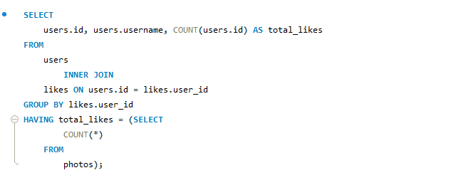
MYSQL QUERY
TASK:
To identify users(potential bots) who have liked every single post on the site.

Slide 36
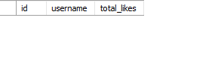
OUTPUT

Slide 37
RESULT
There are no bots on Instagram.

Slide 38

SUMMARY
01
USER ENGAGEMENT
The average number of posts is 5.14
There are no bots
02
BOTS AND FAKE ACCOUNTS
Objectives Powerpoint Template

Slide 39

Throughout this project, I have come to appreciate the importance of MySQL. It is a powerful tool for analyzing data quickly and efficiently, regardless of the size of the database. While working on this project, I gained knowledge of various functions and queries, and I made every effort to answer all of the questions with accuracy.

Slide 40
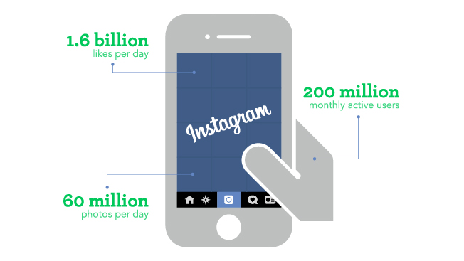


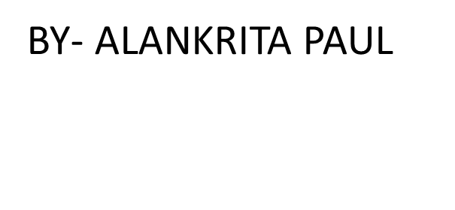
THANK YOU

